Slide 1
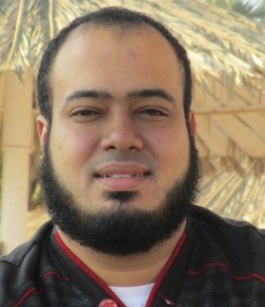
Competitive Programming From Problem 2 Solution in O(1)
P
T
H
I
N
K
F
A
S
T
S
Programming Competitions: What and Why
Mostafa Saad Ibrahim
PhD Student @ Simon Fraser University

Slide 2

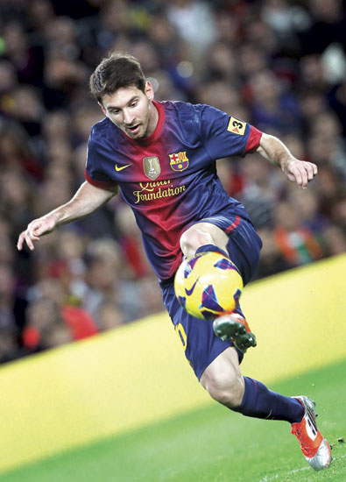
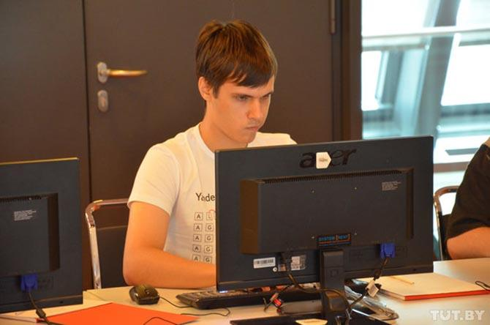
Why doing countless hours of training?
Roger Federer
Lionel Messi
Gennady Korotkevich

Slide 3
Programming Competitions
Programming Competitions (Competitive programming) is a mind (sport) competition
It is a hobby and much fun for many
Task is solving computational problems
Competition can be individuals or teams
Competition can be online or onsite
Problems may be sorted by complexity
Problems may be known algorithms or adhock

Slide 4
Why Competitions?
Matter of knowledge learning vs skills over it
Knowledge = easy + takes short time
Skills =hard + takes much time
Knowledge needs reading, Skills need practice
Algorithms & Data structures = Knowledge
Algorithmic Problem Solving = Skills
Competitions is your gateway to do much practice to build Algorithmic Solving skills

Slide 5
Gains from competitions
Algorithmic thinking skills
Speed, Coding, Debugging, Testing Skills
Correctness of code almost from first time
Teamwork - Working under pressure
Time and Resources management
Prioritizing skills (which problem?)
Challenge spirit..Accept to fail..raise up
Challenge your boundaries and push them
Adaptive behaviour (based on team status)

Slide 6
Gains from competitions
One critical gain from competitions is the increase of your tools (data structures, algorithms, tricks and workarounds, ...etc)
Imagine, 2 engineers are working on a task, facing a problem. One never shared in competitions and other is guru in them.
For computational problems, first one may just know 1 way to do it, the other one knows e.g. 4 ways and know pros and cons of each!

Slide 7
Gains from competitions
Travelling...Meeting smart people
Cash ….. if won
Much good fame among your colleges :)
Getting job in Giant companies (e.g. Google)
….

Slide 8
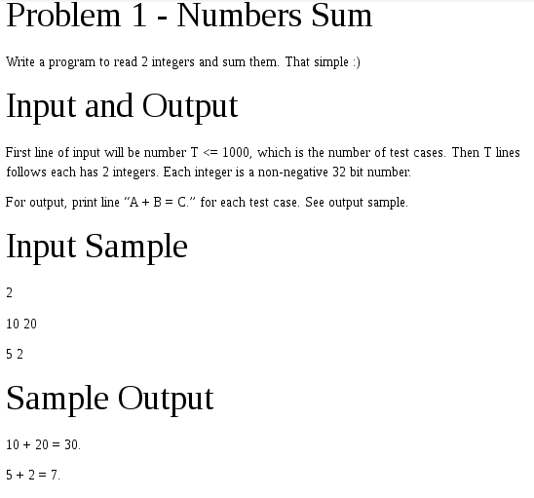
Problem Statement

Slide 9
Competitions Styles
Onsite
ACM ICPC (college level). 3-4 levels.
IOI (secondary schools). 2 Levels.
Google’s Code Jam, Facebook's Hacker Cup, Topcoder Open, Yandex.Algorithm (online rounds, then onsite)
Online
Codeforces and Topcoder
Codechef, Hackerrank, Codility, CodeFights
Others: Bitwise, IEEEXtreme, Al Zimmermann’s
Teams (ACM ICPC, IPSC) vs Individual (IOI and most of online competitions)

Slide 10
Competitions Styles
Source code submission
You should submit your actual solution
Usually expected solution to run in little seconds (may be mentioned)..using specific languages
Examples: ICPC, IOI, Topcoder, Codeforces, UVA..
Output file submission
You submit output file. Write code in whatever language and may run it for minutes / hours
Examples: Codejam, Hackercup, IOI, IPSC
More: Contest time, Structure, Eligibility, Elimination rounds, Judge response, Scoring

Slide 11
Competitions Styles
You don’t have to study all these differences
Through your next years, you will learn them based on need.
For now care with:
Onsite: ACM ICPC
Online: CodeForces(CF) and Topcoder(TC)
And may be - Online Judges: UVA, SPOJ
When some new contest about to occur (e.g. CodeJam), just read about its details.

Slide 12
Online Judges
An online judge is an online system to test programs in programming contests and offline practice.
Most of the contests have online judges to allow people practice anytime
Topcoder and Codeforces have regular contests, and after contest problem put on the OJ for practice
Other OJs: UVA, SPOJ, Timus...

Slide 13
Competitions Challenge Phases
In some online competitions, they allow you to check others code and challenge\hack it with a test case
If code failed, you get points..otherwise lose
Topcoder do that directly after the competitions..Codeforces during it
Much fun for many..learn to understand others code well..find case against it

Slide 14
Required Training Effort
There is no minimum training hours...just train as much as possible
Make it for fun/hobby...and you will put countless hours
What is good average of problems to solve daily? => problems levels? your level?!
Can I do it to ICPC finals in 1 year? Very challenging! In 2 years? Challenging but doable. 3 years? Yes possible.
To be in top 20 in ICPC? We never did it :(

Slide 15
Offline training only
Some people don’t like to join the contest. Just like to do some offline training by solving on different online judges
This is still a good thing, and you will learn many things such as coding and debugging
You will just miss fun of competitions and some skills such as team communication
But it still better than no algorithmic training

Slide 16
Should old graduates practice?
Some says, I am graduate since 2-3 years, never knew about ICPC, is it beneficial to participate in solving ? I am already in market
IF you wish to join giant companies (e.g. Google) => Highly advised
Otherwise => It is ok, but may be better now to focus on the many market needs of skills / knowledge of languages / technologies
Or target by passing juniors level

Slide 17
Programming Languages
C++ and Java are the most popular languages in online judges (main in ICPC)
Topcoder offers too python and C#..
Codeforces too allows variety of languages
Most of competitive programmers use C++
C++: Faster and shorter in code, superior in most cases
Debugging/Catching errors in Java much better (eclipse)
Java beats in some packages: Math, Geom (more in past)
Generally, going with any of the 2 languages is fine. Learning both is good and easy.

Slide 18
Competitions & Industry
All gained skills directly affect your career
Competitions keep you aware with your code performance
Some fields are popular in industry (Graph)
Some companies (especially top) have algorithmic interviews...they even run competitions
CodeJam for Google, Imagine Cup for Microsoft...etc
Why? software must be efficient to manage millions users

Slide 19
Competitions & Industry
Competitions build your algorithmic background, which ease on you algorithmic interviews (e.g. by Google, Facebook, Microsoft, Amazon, Dropbox, Quora..etc)
However
You can gain such skills by practice on interviews books
You may be strong in competitions and fail to get accepted by a top company. Why? It depends on many other factors such as available opportunities, your other skills-knowledge, your CV, level vs others interviewing..

Slide 20
Competitions & Industry
Remember, success in industry needs much more other skills and areas of knowledge
Also, the learned skills from competitions simplified version from industry ones.
E.g. in market you need time management skills to manage a project for 5+ months not for 5 hours contest
Similarly, teamwork, Prioritizing skills..are more complex
Many good software engineers never shared in competitions..it is optional, but highly advised

Slide 21
Competitions & Industry
Things you won’t face in competitions
A large problem that need months of work
A problem with changing requirements
Approximate/randomized/parallel algorithms
Caching, external memory accesses, device errors, ...
Interactive problems (e.g. online game)
No customer experience with your product
Many algorithmic problems and data structures rarely used in real life applications.
Codeforces Div2-C & Topcoder Div2-500 are realistic levels for what you may need in market

Slide 22
Tips
If you are graduate with extreme problem solving skills...and nothing else = SO BAD
Be careful from the bad programming habits
Hate: writing comments, OOP, Software Design
Like: short variable names, everything global, algorithmic problems only
Do: So fast unnecessary code, even if not maintainable
Get the pros...and be careful from the cons
Care with other skills...do many normal projects
Learn to code professionally (read clean code book)

Slide 23
Tips
Give high attention to competitions in first 2 years
In parallel, do many console projects
In later years, minimize competitions time, put time in software engineering, learn new languages, technologies (web, mobile, frameworks, Database)
Little less in 3rd..and minimize more in 4th
Explore and be clever in some other intersting fields such as operating systems, networking, security...etc
Share in open source..Google summer of code

Slide 24
Materials
My channel
Books
Competitive programming, Programming Challenges
Art of Programming Contest book (free)
Algorithms books
Tutorials: Topcoder
Written Algorithms:
Link 1. Link 2. Stanford notebook. Russian site
Online Judges for practice

Slide 25
Other types of competitions
Software Design / Architecture Competitions
Assembly competition
TopCoder Marathons
Artificial Intelligence competitions
Kaggle, HackerRank, Codingame, AI Challenge...
Game Programming Competition
Cyber Competitions
More: See 1, See 2

Slide 26
تم بحمد الله
علمكم الله ما ينفعكم
ونفعكم بما تعلمتم
وزادكم علماً

